Slide 1

Automated Misinformation Detection
From Stylistic Analysis to Neuro-Symbolic Verification
Airost Internship
Mohamed Alwathiq Ali

Slide 2
CONTENTS
01.
04.
introduction
Phase 2 RAG
02.
05.
Phase 1 LSTM
Cross-Attention Core
03.
06.
The Trap
Verdict & Demo

Slide 3
01
Intro

Slide 4

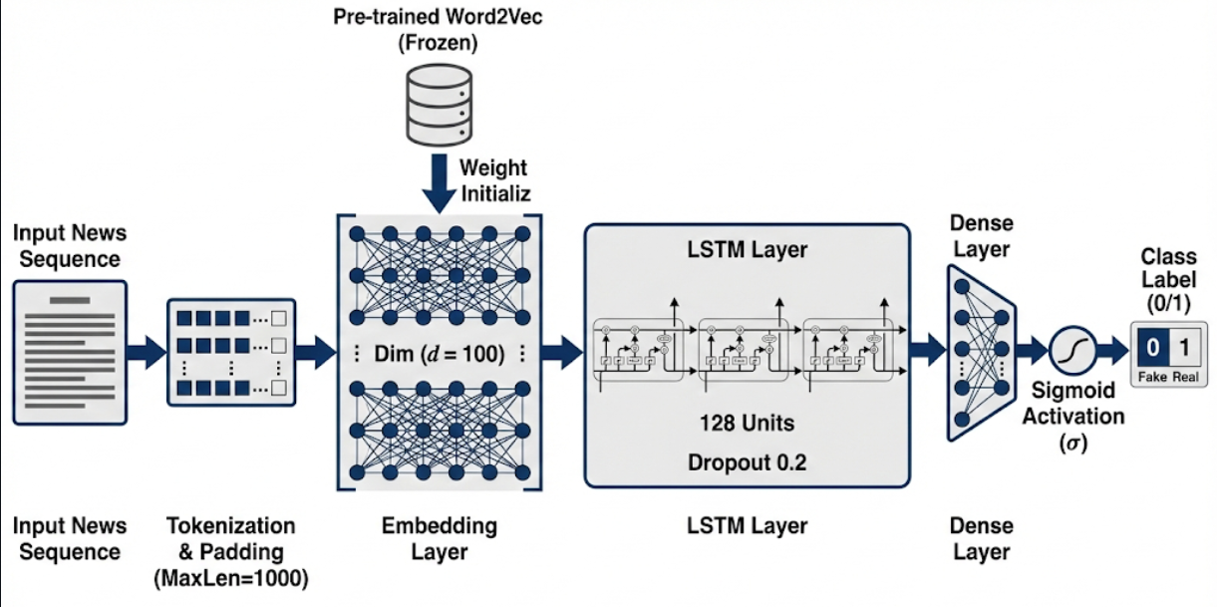
Phase 1: The Stylistic Baseline
A Bi-Directional LSTM model was built to detect fake news based on linguistic patterns and writing style. It treated news as a sequence, looking for cues like sensationalism vs. formality.
Embedding: Pre-trained Word2Vec (frozen weights).
Core: Bi-Directional LSTM (128 units).
Output: Binary Classification (Real vs. Fake).
Dataset: Kaggle "Fake and Real News" (2017).

Slide 5
The "99% Accuracy" Trap
High in-domain accuracy masked a critical flaw: the model learned style, not substance.
Kaggle Dataset (2017)
LIAR-2 Dataset (2024)
99.1%
~26%
Accuracy
Accuracy
The model was a stylistic classifier, not a fact-checker. It failed against "well-written lies" and new political contexts.

Slide 6
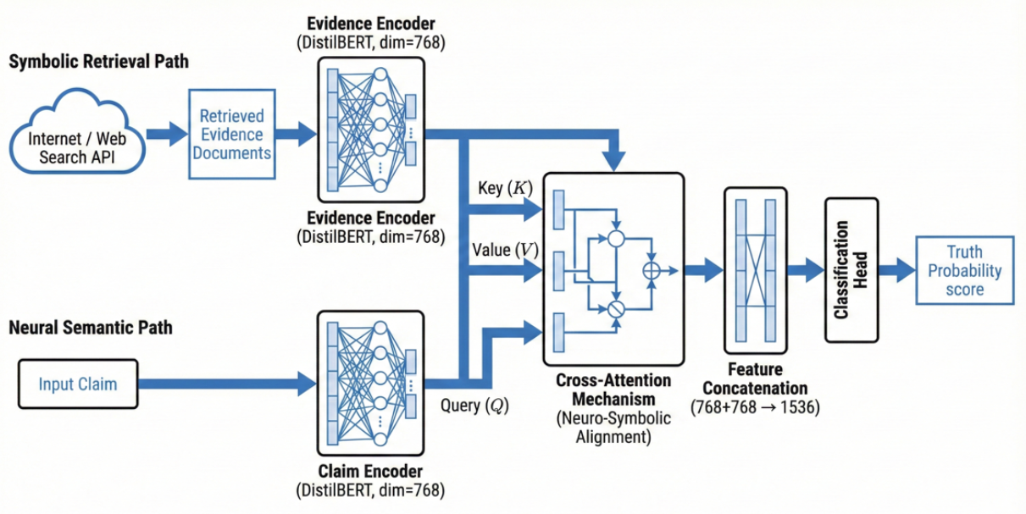
Phase 2: The Neuro-Symbolic Pivot
The failure led to a new approach: Retrieval-Augmented Generation (RAG). This model doesn't just read the claim—it actively searches for evidence to verify it.
Neural Path
Encodes the input claim using BERT for deep understanding.
+
Symbolic Path
Fetches live evidence from the web via DuckDuckGo API.

Slide 7
Results & Comparative Verdict
Phase 1: LSTM
Phase 2: Neuro-Symbolic
Accuracy: 99% (on static 2017 data)
Accuracy: ~70% (on harder 2024 data)
Robustness: Failed on new topics
Robustness: High (Live Search)
Mechanism: Pattern Matching (Style)
Mechanism: Fact Verification
Data Dependency: High (100% static)
Data Dependency: Low (30% used)
Conclusion: Access to external, live evidence is more powerful than memorized stylistic heuristics for building a robust fake news detector.

Slide 8
06
Demo

Slide 9

Thank You
Mohamed Alwathiq
Team Pleiades

